Slide 1
CS Club Weekly Meeting
02/25/20

Slide 2
Agenda
Announcements
Python & Flask example

Slide 3
Announcements
From Professor Yoon -
“Hartford Public Library's Newcomer Teens program, which provides after-school tutoring to new immigrant teens in the area. They are searching for a volunteer to help with tutoring on AP Computer Science 1-2 times per week. Do you have any Trinity students you know that may want to volunteer virtually?”
----------------------
Slides will now be posted on the club’s Github the morning after we have a meeting under the “slides” repo.
----------------------
NAMING CONTEST: We need to come up with a funny/clever name for our Raspberry PI, I will send out a survey tomorrow, and we can vote on the best ideas for a name. I look forward to reading your entries

Slide 4
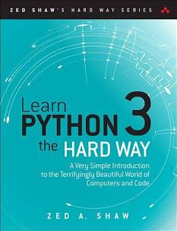
From page 216 of LP3THW
“Before creating your first web application, you’ll need to install the ‘web framework’ call flask. The term ‘framework’ generally means ‘some package that makes it easier for me to do something.’ In the world of web applications, people create ‘web frameworks’ to compensate for the difficult problems they’ve encountered when making their own sites. They share these common solutions in the form of a package you can download to bootstrap your own projects.
In our case, we’ll be using flask, but there are many, many, many others you can choose from. For now, learn flask, then branch out to another one when you’re ready (or just keep using flask since it’s good enough).

Slide 5
Installing flask
For mac and Linux users on the terminal enter: sudo pip3 install flask
For Windows users: pip3 install flask
Important! Make sure that your pip3 version is pointing to the same version of python3 that your python3 is pointing to. A simple way to check this (for UNIX people) is to enter python3 --version followed by pip3 --version on your terminal. They should by both say python3.x (where x is the same for both pip3 and python3)

Slide 6
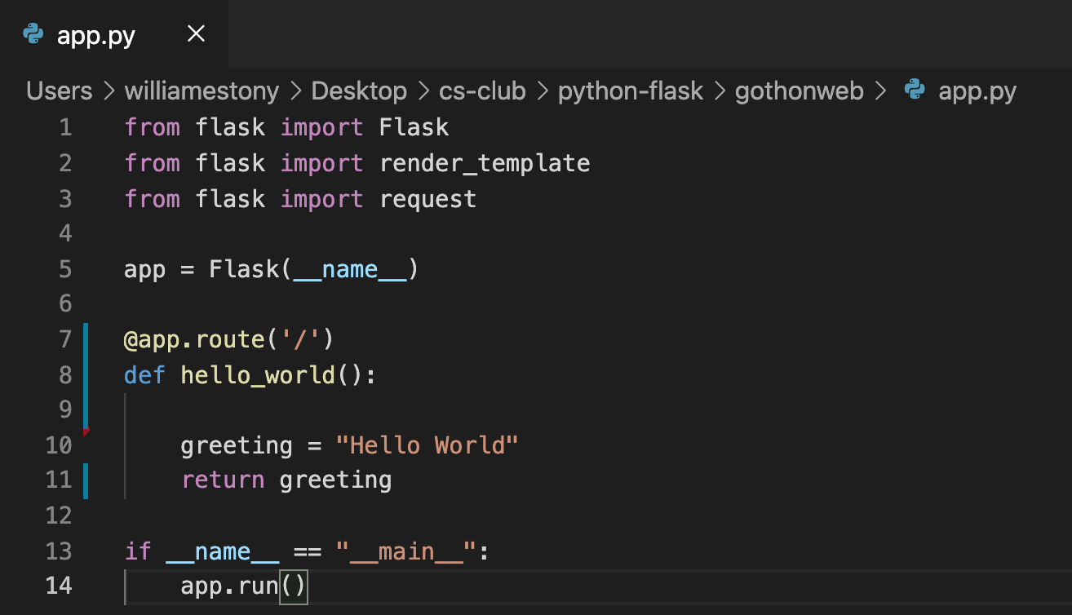
In a file called app.py….

Slide 7
Now start the server...
In your terminal:
python3 app.py
This will start up the server which will run forever until you force it to stop (CTRL-C)
To check that everything works, go to your browser of choice and enter 127.0.0.1:5000
Your browser should give you a white screen that says Hello World
Your terminal should print something like: 127.0.0.1 - - [25/Feb/2021 18:01:36] "GET / HTTP/1.1" 200 -
200 means SUCCESS, anything with a 400 is typically some sort of error

Slide 8
What do we do with this...
When you entered that url into your browser, your browser was talking directly to your own computer (localhost). Ideally, we host that hello world page on our raspberry pi (this article explains how to do that). So you enter some non-local-host-url into your browser and now you’re communicating with the the raspberry pi (pretty cool!)
We also want to make it say and display things that aren’t hello world (more on this to come).

Slide 9
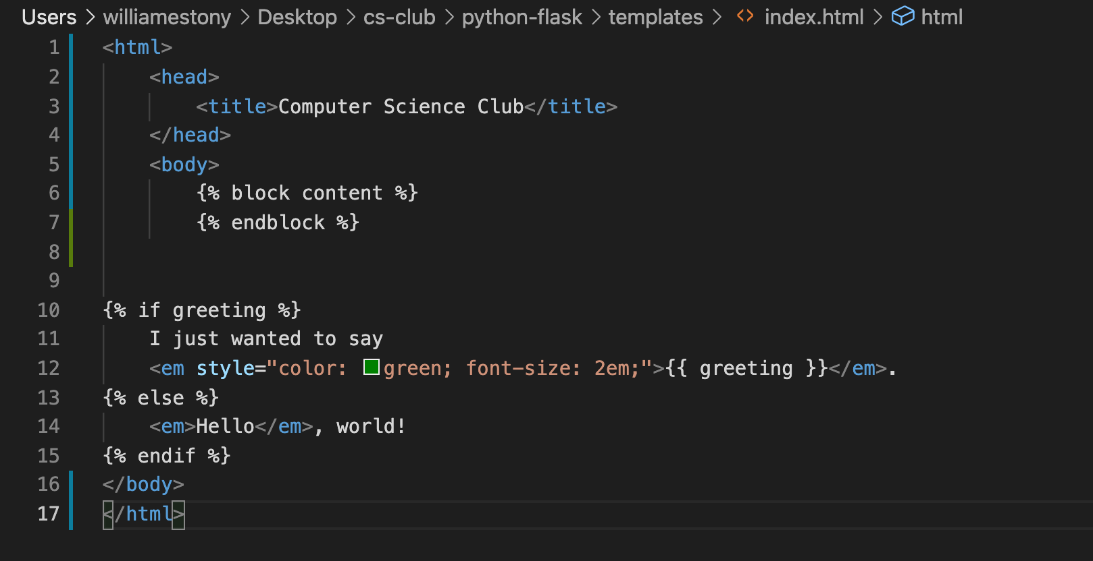
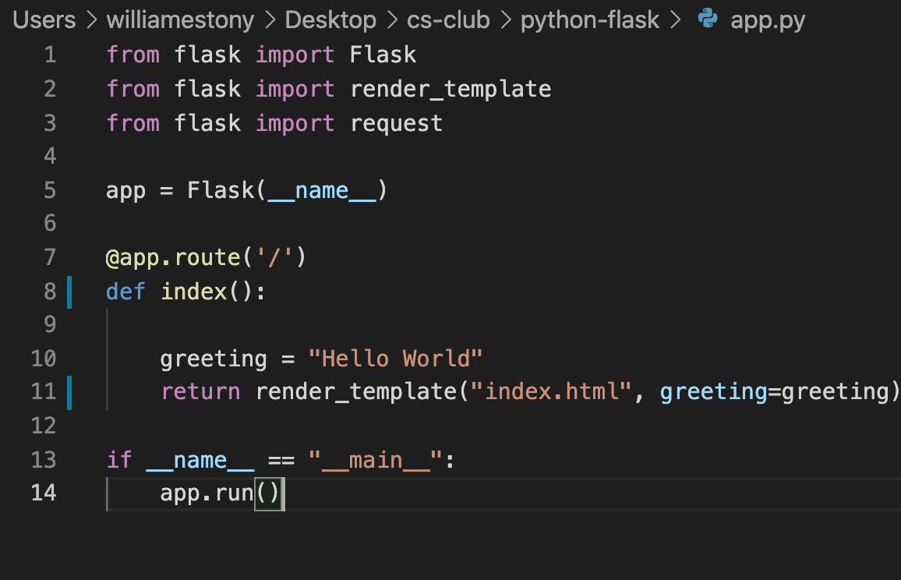
Create Basic Templates
In the same folder you made app.py, create a sub-folder and call it templates
Make a file in templates called index.html
This file contains a mix of html code, and Jinja2 formatting
You will also need to update the function call in app.y
Change from hello_world() to index()

Slide 10
If you are completely lost...
That is a totally okay and normal feeling…. Don’t panic!
In the github repository located at this link: https://github.com/trinCollCSClub/python-flask there is a file called lp3thw which is a pdf of two chapters from the book: Learn Python 3 the Hard Way, (apologies for the crappy screenshots), it contains information about everything we did tonight, plus more!

